Slide 1

CARE INDIA
Welcomes you all

Slide 2
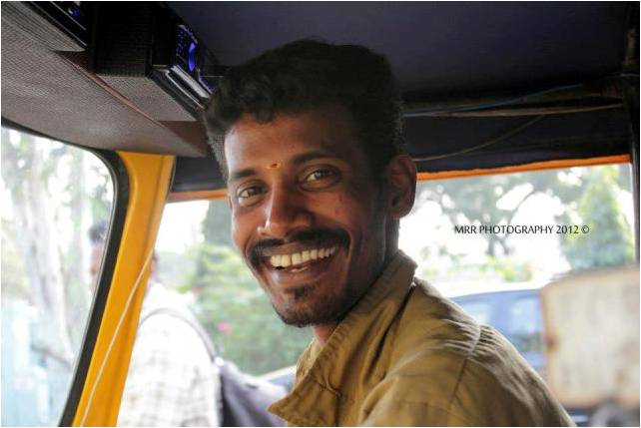
Vision
Enriched lives

Slide 3
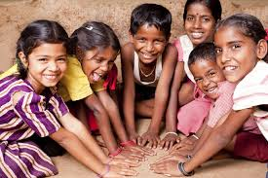
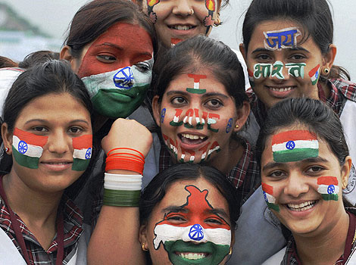
CARE INDIA - Mission
“Holistic Development of the community to lead a LIFE with QUALITY and DIGNITY – Transformed by LOVE”

Slide 4
CARE INDIA – Core Value
We are… 3C
Working with………..
Compassionate
Caring
Connecting with people
Integrity
True Stewardship
Being Responsive
Value People
Fostering Growth
Aspired to Transform Lives

Slide 5
OBJECTIVES
“SMILE LIFE” – Serve Motivate Individuals to Lead a
Empowered Life
HELP Now!!!
Health - Tulsi
Education - Vidya
Livelihood - Jeevanadaraa
Partnership - Sathi
Relief - Zindagi

Slide 6
Tulsi – Touching Lives through Health Care
To Practice, Promote, Provide, alternative system of medicine ( Ayurveda, Sidda )
To develop and raise herbal nursery, promote organic farming
To construct and maintain drinking water projects, solar power energy in Rural areas and urban slums
Croud Funding Medical Financial Assistance for Emergency Medical Treatment,

Slide 7
VIDYA – Fostering Growth through Education
To create awareness about Right to Education and Strive for total Success of RTE..
To establish, maintain aid to students, supply of books and run studentships, scholarships to deserving students…
Trainings in Life skills, Occupational Health and Safety, Career Guidance, etc…..
Vocational Training for the economically backward
Establish and Partner with Centers for imparting Vocational Training

Slide 8
JIVANADHARA – Empowering Lives through Livelihood Programs
Sustainable Income Generating Programs
To impart Job Oriented education, create employment opportunities for the youth
Conduct Leadership Training Programs encouraging Self Help Groups, Youth Associations, Children Club forums.
To promote and encourage growth of cottage and small scale industries by providing sustainable Livelihood Materials Assistance

Slide 9
SAATHI – Bridging Lives through Partnering
Partner and Promote in Organizing camps, training programs, competitions, seminars, conferences, tours, tournaments, games in order to develop creativity Personality and scientific outlook among youths
Networking with various likeminded NGOs, similar agencies and work towards Peace, Care and Protection

Slide 10
ZINDAGI – Restored lives through Relief and Disaster Preparedness
To Conduct awareness programs such as safety, prevention of accidents
To promote solidarity and social harmony amongst cross sections of the society
To grant relief and assistance to the needy victims during natural calamities

Slide 11
We Demonstrate……..
Trust
Commitment to Values
Courage to walk the Untrodden Path
Optimistic
Learning from Experience
Accountability

Slide 12
Accountability
God Almighty
Sponsors
Sponsored Children and Families
Communities
Networking Partners

Slide 13
Care India is …….
A Calling depending on Prayer and the grace of God
About being Christian, not discriminating on the basis of Religion
About Quality with Commitment and Compassion
About being the Change…… being the Change Agents…….
About Walking along with the poor trusting God
About serving humanity
Serving without any expectations, with sincerity and with no strings attached
About pursuing every opportunity to touch people with the Love of GOD
About providing children and Communities with better opportunities
About Shaping the personality of children and Youths
An opportunity to contribute to society
A Selfless Service and a will to progress
A people friendly organization demonstrating love for people
3L – TO Love, To Learn and To Leave a Legacy

Slide 14


Thank You
Take Care

